Slide 1
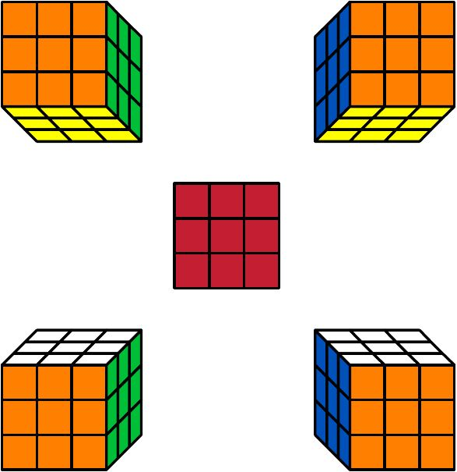
The Rubik’s Cube
David Fudge
Western Illinois University

Slide 2
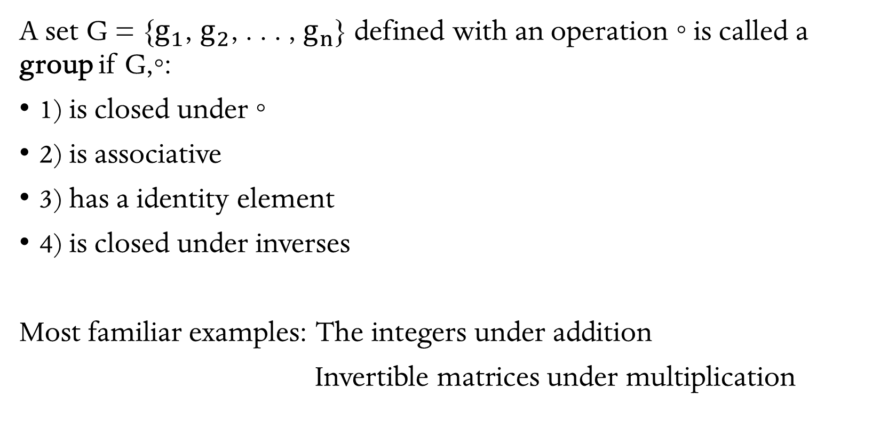
Groups
A set G = {$g_{1}$, $g_{2}$, . . . , $g_{n}$} defined with an operation ◦ is called a group if G,◦:
1) is closed under ◦
2) is associative
3) has a identity element
4) is closed under inverses
Most familiar examples: The integers under addition
Invertible matrices under multiplication

Slide 3
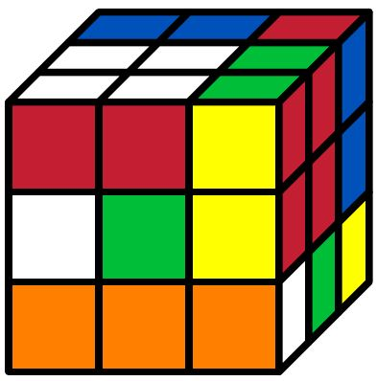
Let the set S = {B, G, O, R, W, Y}.
For example, looking at the Cube after the action YRWO gives:
(We are performing the action YRWO from right to left)

Slide 4

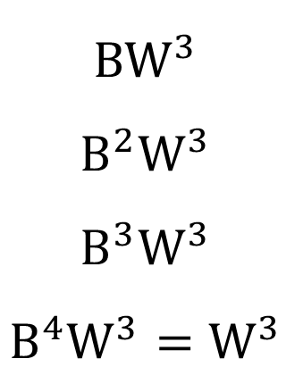
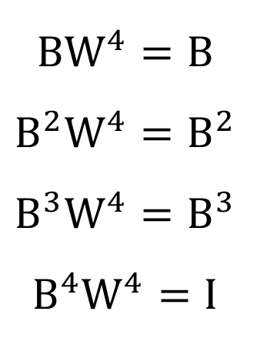
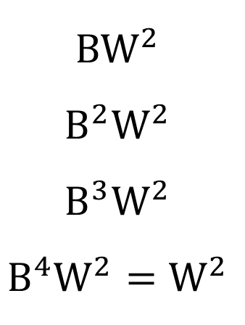
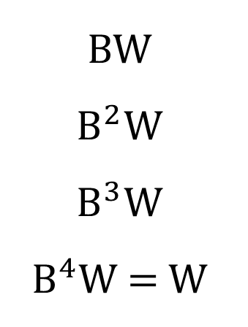
S is NOT a group. We want to define a group for the Rubik’s Cube.
Define $S_{G}$ as the group generated by the elements of S. For example, YRWO is not an element of S, but is an element of $S_{G}$.
Some more elements of $S_{G}:$
B
$$B^{2}$$
$$B^{3}$$
$$B^{4}=I$$
BW
$$B^{2}\text{W}$$
$$B^{3}\text{W}$$
$$B^{4}\text{W}\text{ = }\text{W}$$
$$BW^{2}$$
$$B^{2}W^{2}$$
$$B^{3}W^{2}$$
$$B^{4}W^{2}=W^{2}$$
$$BW^{3}$$
$$B^{2}W^{3}$$
$$B^{3}W^{3}$$
$$B^{4}W^{3}=W^{3}$$
$$BW^{4}=B$$
$$B^{2}W^{4}=B^{2}$$
$$B^{3}W^{4}=B^{3}$$
$$B^{4}W^{4}=I$$

Slide 5
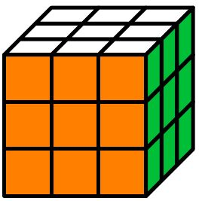
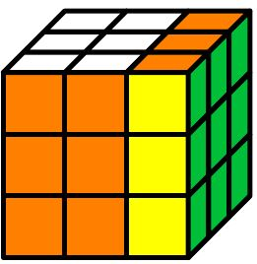
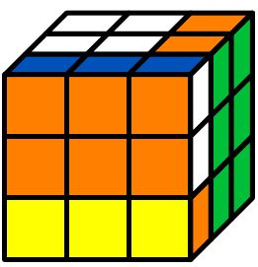
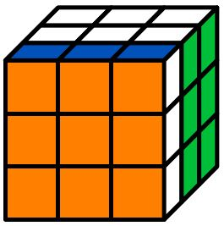
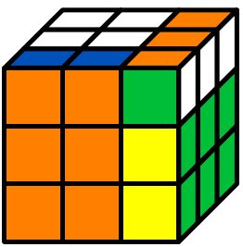
Not all elements of $S_{G}$ commute.
OG
GO

Slide 6
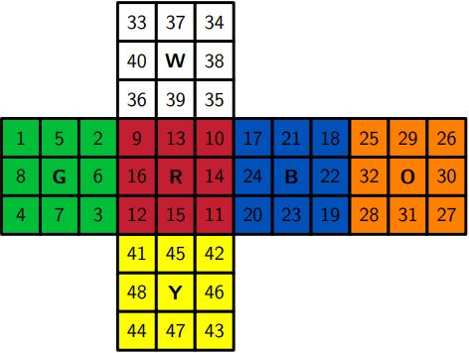
Permutation Groups
We can redefine $S_{G}$ as a permutation group. Our first step is to label the Rubik’s Cube as such:
What is a permutation?

Slide 7
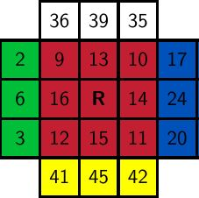
R is the composition of the following permutations:
( 9 10 11 12 )
( 13 14 15 16 )
( 2 35 20 41 )
( 3 36 17 42 )
( 6 39 24 45 )

Slide 8

Defining R, G, O, B, W, Y as permutations transforms $S_{G}$ into
a permutation group. What is the order of this group?
1) Corner cubie positions:
2) Corner cubie orientations:
3) Edge cubie positions:
4) Edge cubie orientations:
8!
Assuming all positions and orientations are obtainable, the order of the Rubik’s Cube group is...
8! $3^{8}$12! $2^{12}$
$$3^{8}$$
12!
$$2^{12}$$

Slide 9
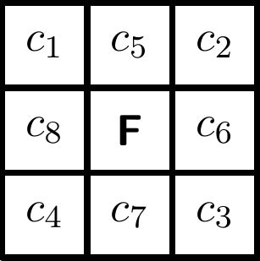

Even Permutations
All permutations can be reduced into a composition of 2-cycles.
Spatially, a face rotation permutes 8 cubies using the center cubie as a fixed point. Decomposing the resulting permutation we get:
($c_{1}$, $c_{4}$)($c_{1}$, $c_{3}$)($c_{1}$, $c_{2}$)($c_{5}$, $c_{8}$)($c_{5}$, $c_{7}$)($c_{5}$, $c_{6}$).
This permutation is even.

Slide 10
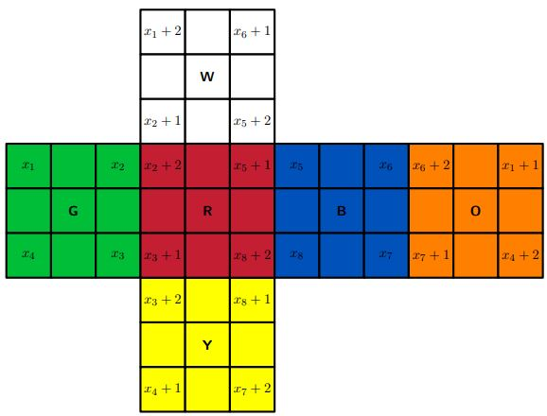
Corner Cubies
Think of a point ($x_{1}$, $x_{2}$, $x_{3}$, $x_{4}$, $x_{5}$, $x_{6}$, $x_{7}$, $x_{8}$).
For any single face rotation, we will replace each $x_{i}$ with the value that replaces it.

Slide 11
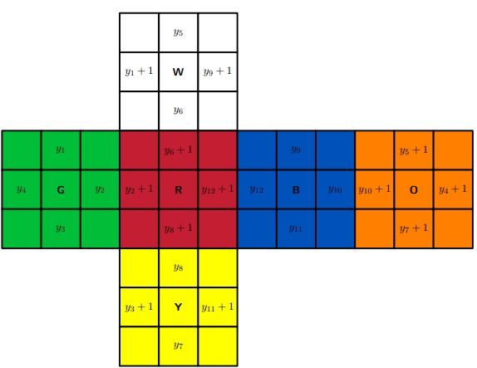
Edge Cubies
Think of a point ($y_{1}$, $y_{2}$, $y_{3}$, $y_{4}$, $y_{5}$, $y_{6}$, $y_{7}$, $y_{8}$, $y_{9}$, $y_{10}$, $y_{11}$, $y_{12}$).
For any single face rotation, we will replace each $y_{i}$ with the value that replaces it.

Slide 12
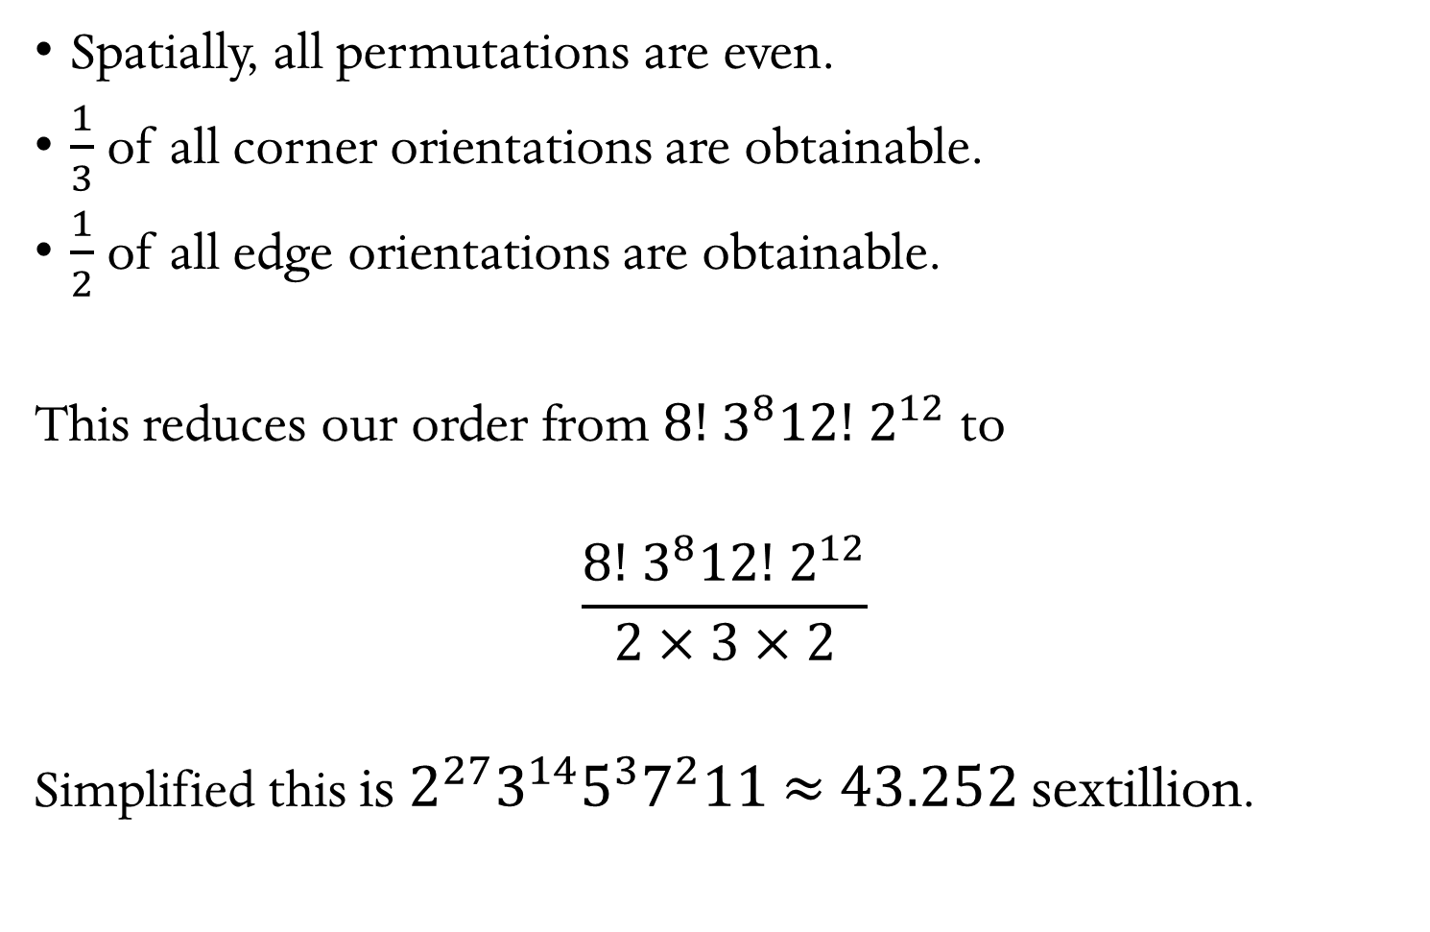
Spatially, all permutations are even.
$\frac{1}{3}$ of all corner orientations are obtainable.
$\frac{1}{2}$ of all edge orientations are obtainable.
This reduces our order from 8! $3^{8}$12! $2^{12}$ to
$$\frac{\text{8! }3^{8}\text{12! }2^{12}}{2×3×2}$$
Simplified this is ${2^{27}3}^{14}5^{3}7^{2}11$ $≈$ 43.252 sextillion.

